Slide 1
Brain Teaser
Inside of a dark closet are five hats: three blue and two red. Three smart men go into the closet, and each selects a hat in the dark and places it unseen upon his head. Each man knows both that the closet contains three blue hats and two red and that the other two men have the same knowledge. Once outside the closet, no man can see his own hat. The first man looks at the other two, thinks, and says, “I cannot tell what color my hat is.” The second man hears this, looks at the other two and says, “I too cannot tell the color of my hat.” The third man is blind. The blind man says, “Well, I know what color my hat is!”
What color is the blind man’s hat and how do you know?
Bonus: What do you call a thought from Tim Tebow?

Slide 2
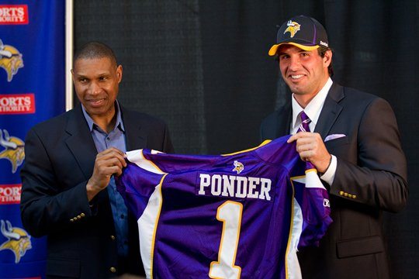
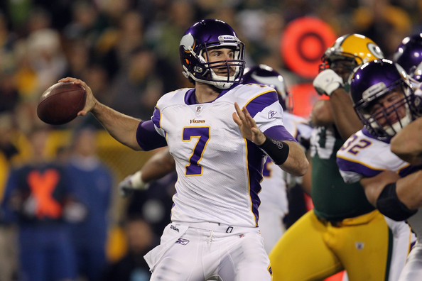
In this game there are three scenarios:
1)first guy see’s blue on both second guy and blind guy; 2)first guy see’s blue on second guy and red on blind guy; 3)first guy see’s red on second guy and blue on blind guy.
keep in mind second guy and blind guy both know that either a) they are both wearing blue or b) between the two one is wearing blue and the other is wearing red.
in scenario #2, the second guy looking at blind guy would be able to deduce that he’s wearing a blue cap since he sees a red cap on the blind and knows that he must be wearing a blue cap. since the second guy also does not know what color hat he’s wearing the blind guy knows this cannot be scenario #2. So he correctly guesses he’s wearing a BLUE cap.
Bonus: A Christian Ponder

Slide 3
Stock Competition Update
Who’s Hot : David – Zynga (short)
Alec – Netflix
Christy – Mastercard
Who’s Not: Luke – Amazon
Spandana – Amazon
Avinash – Facebook

